Slide 1
Intervention Mapping Step 2: Program Outcomes and Objectives – Logic Model of Change

Slide 2
Intervention Mapping Steps
Logic model of the problem
Program outcomes and objectives (logic model of change)
Program design
Program production
Program implementation plan
Evaluation plan
Notes:
Previously, in Step One, you created a Logic Model of the Problem, or a RISK model, which clearly specified the poor health and QOL outcomes that your priority population is facing, as well as the risk behaviors and environmental conditions that are contributing to the health problem.
In Step 2 you will develop a Logic Model of Change, which is a HEALTH-PROMOTING model. This Logic Model clearly states what needs to change, in behavior and in the environment, to improve those health and QOL outcomes.

Slide 3
Step 2: Tasks
State expected outcomes for behavior and environment
Specify performance objectives for behavioral and environmental outcomes
Select determinants for behavioral and environmental outcomes
Construct matrices of change objectives
Create a logic model of change

Slide 4
Task 1: State Expected Outcomes for Behavior and Environment
Start with your PRECEDE model (risk model)
ASK - what needs to change in the behavioral and environmental risks factors to have improved heath outcomes?

Slide 5
What Needs to Change?
INSERT Figure 1.2 HERE

Slide 6
What Needs to Change?
Do the FLIP!
INSERT Figure 1.2 HERE

Slide 7
Selecting Behavioral Outcomes
Stated in terms of the behaviors to be accomplished as a result of the health promotion program
Risk-Reduction Behaviors
Health-Promoting Behaviors
Adherence and Self-Management Behaviors

Slide 8
Stating Behavioral Outcomes
Consume less than 10 percent of calories from saturated fats
Use condoms correctly and consistently when having sexual intercourse
Engage in moderate to vigorous physical activity at least 150 minutes a week
Take antiseizure medications as prescribed by a health care provider
Women ages 50–74 years obtain a mammogram every two years

Slide 9
Identifying Environmental Outcomes
Interpersonal Environment
Organizational Environment
Community Environment
Society
Prioritize by relevance and changeability

Slide 10
Environmental Factors Related to Health Outcomes
Social or physical conditions
Act as a direct cause of the health problem
Or, cause the health problem indirectly through behavior

Slide 11
Interpersonal Environment
Families - primary influence for socialization of children and continue to effect behavior throughout life
Peer groups - beginning with playmates and continuing with friends, neighbors, coworkers, and members of organizations with which individuals affiliate (e.g., churches, social clubs, service groups)
Influential roles - special influence through a role, (e.g., teachers, coaches, religious leaders, health care providers)
Support from social networks - emotional support, information or advice, material support, maintenance of social identity, and social outreach

Slide 12
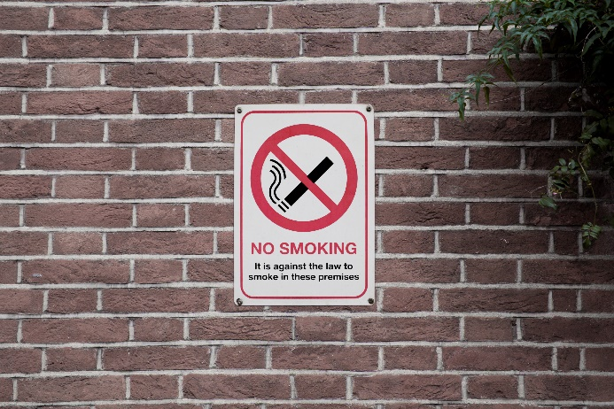
Organizational Environment
Norms
Policies
Practices
Facilities
Examples of health-related organizational factors:
Policies that exert strong control over behavior (e.g., worksite bans on smoking).
Health care facility characteristics (e.g., service hours might determine whether workers obtain care).

Slide 13
Community Level Environment
Access to health care
Availability of recreational resources
Smoking and other health ordinances
Treatment resources for social problems such as child abuse, violence, and drug addiction
Social capital (capacity of the community to form and maintain health-promoting coalitions)

Slide 14
Societal Level Environment
Legislation
Enforcement
Regulation
Resource allocation
Policies, programs, and facilities of large political and geographic groups

Slide 15
Stating Environmental Outcomes
Stated in terms of the environmental outcome to be accomplished as a result of the health promotion program
Parents/caregivers support preschoolers to be more physically active
Food service directors modify purchase order specifications to reduce the fat content of vendor-prepared foods and to increase fresh fruits and vegetables
Off-premise alcohol outlets comply with underage drinking laws
State legislators prohibit smoking in all enclosed public places in the state

Slide 16
Task 2: Specify Performance Objectives for Behavioral and Environmental Outcomes
Performance Objectives for Behavior
What do the participants in this program need to do to perform the behavior stated in the behavioral outcomes?
Sub-steps of behavioral outcomes

Slide 17
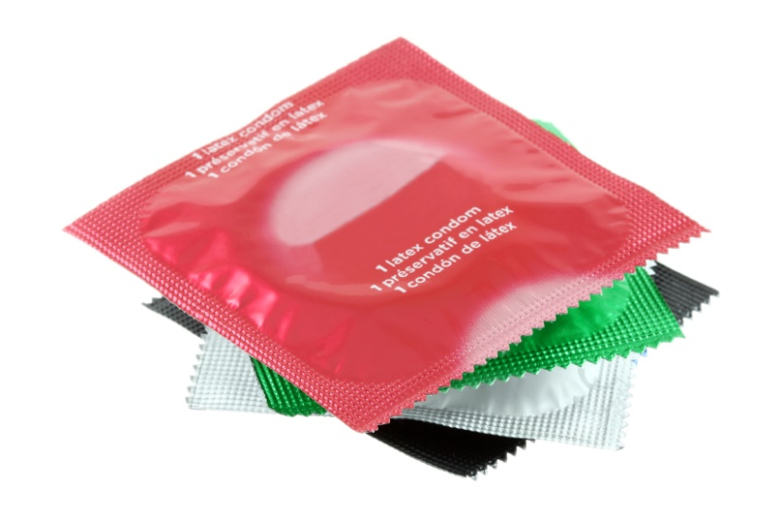
Use Condoms Correctly and Consistently
Make the decision to use condoms
Buy or obtain condoms
Carry condoms or have condoms easily available
Negotiate the use of a condom with a partner
Correctly apply condoms during use
Maintain use over time

Slide 18
Take Antiretroval Treatment (ART) as Prescribed
Follow and integrate the treatment plan properly in the daily routine
Handle situations in which ART is difficult to take
Cope with side effects
Interact and deal with health professionals
Maintain relationships with resources person and immediate social circle

Slide 19
Performance Objectives for Environmental Outcomes
What does someone in the environment need to do to accomplish the environmental outcome?
Performance objectives for environmental outcomes must include “Who” will perform the action

Slide 20
Specifying Performance Objectives for Environmental Outcomes
Food service directors will modify menus so that all meals contain three choices of fruits and vegetables with no added sugar
Food service directors will modify purchase order specifications to reduce the fat content of vendor-prepared foods and to increase fresh fruits and vegetables
Nutritionists will modify recipes to find appetizing/attractive presentations of fruits and vegetables
Nutritionists will replace most desserts with fruits and grains
Cooks will modify cooking practices to follow new recipes

Slide 21
Validating Performance Objectives
Self-report by individuals performing behavior or changing environment
Observation of behavior or environment change
Expert consensus
Performance objectives predict or correlate with behavior

Slide 22
Task 3: Select Determinants for Behavioral and Environmental Outcomes
Factors associated with the performance of the health behavior of the priority population
Factors associated with the behavior of environmental agents that have control or influence over environmental outcomes

Slide 23
Types of Determinants
Cognitive factors (knowledge, attitudes, beliefs, values, self-efficacy, and expectations)
Capabilities, such as skills
Affective factors (feelings, anxiety, fears, and emotions)

Slide 24
Use Core Processes to Select Determinants
Pose a question
Why would a person perform a particular health-promoting behavior?
Why would a certain environmental agent make an environmental modification?
Brainstorm provisional list of answers
Review findings from the empirical literature for theory- and evidence-based answers to questions
Review theories for additional constructs
Assess and address need for new data
Formulate a working list of answers

Slide 25
Rate Importance of Determinants
Rate each determinant in terms of relevance (strength of association with the behavior) and changeability (how likely it is that health promotion intervention will influence change in the determinant)
INSERT Figure 5.6 HERE
Figure 5.6

Slide 26
Task 4: Construct Matrices of Change Objectives
Create a matrix of change objectives for each level of intervention planning.
Individual
Interpersonal
Organizational
Community
Societal
By crossing performance objectives with determinants and writing change objectives

Slide 27
Create Matrices of Change Objectives
 | Determinant 1 | Determinant 2
Performance Objective 1 | Change Objective | Change Objective
Performance Objective 2 | Change Objective | Change Objective

Slide 28
Consistently and Correctly Using Condoms During Sexual Intercourse Determinants
Performance Objectives | Knowledge | Skills and Self-Efficacy | Outcome Expectations | Perceived Norms
PO.1. Purchase or obtain condoms | K.1. Explain how and where to buy or obtain a condom | SSE.1.a. Demonstrate the ability to buy or obtain a condom SSE.1.b. Express confidence in ability to deal with embarrassment when buying a condom | OE 1. Expect that buying or obtaining condoms will result in more routine condom use | PN.1. Explain that peers go into stores and buy condoms
PO.2. Carry condoms or have condoms easily available | K.2. List private, effective places to keep condoms | SSE.2. Express confidence that can find a private, safe, accessible place for condoms | OE.2. Describe how having condoms easily available will result in more routine condom use | PN.2. State that peers have condoms easily available
PO.3. Negotiate the use of a condom with a partner | K.3. List the steps of successful negotiation | SSE.3.a. Express confidence in ability to negotiate condom use with partner, or not have sex SSE.3.b Demonstrate the ability to negotiate condom use with partner, or else refuse to have sex | OE.3. Describe personal beliefs that negotiation will lead to positive experience where both partners are satisfied and result in condom use | PN.3. Explain that peers talk to their partners about condom use

Slide 29
Differentiating the Intervention Population
Age and gender
Cultural group
?
Socioeconomic status, education
Geographic location
Stage theories

Slide 30
Differentiation by Developmental Stage
In the Cystic Fibrosis Family Education Program, planners asked: What should the child with cystic fibrosis be able to do to manage the disease?
Because the ages of children in the CF population spanned the range of 4 through 18 years, the planners asked how the performance objectives would be different for the developmental stages represented by:
Preschoolers ages 4 through 6
School-age children ages 7 through 11
Adolescents ages 12 through 18

Slide 31
Task 5: Create a Logic Model of Change
INSERT Figure 5.1 HERE
Figure 5.1

Slide 32
Example
It’s Your Game…Keep It Real (IYG)
A sexual health education program for middle school students

Slide 33
Task 1: State Expected Outcomes for Behavior and Environment
From the need assessment, the planning group identified the primary health-related behavior outcome for the priority population (middle school students) as:
Choose not to have sex
Additional behavioral outcomes:
Have healthy friendships and dating relationships
Use condoms correctly and consistently when having sex
Use an effective method of birth control along with condoms
Obtain regular testing for pregnancy, HIV, and STIs if sexually active

Slide 34
Environmental Outcomes (Interpersonal)
Parents communicate with their child about dating, intimate/healthy relationships, and sexual behavior
Parents monitor their child’s time, friendships, and dating activities

Slide 35
Task 2: Specify Performance Objectives for Behavioral and Environmental Outcomes
Clarify the exact performance expected from someone affected by the program
Observable subset of performance
What do the participants of this program need to do to perform the behavior?

Slide 36
Example: Performance Objectives for Students Will Choose Not Have Sex
Students will:
Make the decision to not have sex
Communicate personal limits to partner regarding sex
Avoid high-risk situations which could lead to unwanted sex, i.e., using alcohol, drugs
Refuse to have sex

Slide 37
Example Performance Objectives for Interpersonal Environmental Outcome: Parents Talk With Child About Sexual Topics
Parents will:
Plan to talk with their child
Talk about advantages of abstinence
Talk about using condoms & contraception if sexually active
Talk about how to avoid risky situations
Listen to child’s feelings and opinions non-judgmentally
Answer questions calmly
Maintain an open channel of communication with their child over time

Slide 38
Task 3: Select Determinants for Behavioral and Environmental Outcomes
The planning group used data from the needs assessment, focus groups, and literature review to identify relevant and changeable determinant for student and parent outcomes
INSERT Figure 5.13 HERE
Figure 5.13

Slide 39
Task 3: Select Determinants for Behavioral and Environmental Outcomes
INSERT Figure 5.14 HERE
Figure 5.14

Slide 40
Task 4: Construct Matrices of Change Objectives
The planning group created:
Five separate matrices of change objectives for the priority group (middle school students)
Two matrices of change objectives for parents at the interpersonal environmental level

Slide 41
Partial Matrix for Students Will Choose Not Have Sex
Performance Objectives | Knowledge | Skills | Normative Beliefs
1. Communicate your personal limits regarding sex to partner | Describe what is a personal limit List ways to communicate personal limits to partner | Demonstrate ability to communicate your personal limits to friends/partner | Significant others approve of communicating personal limits about sex
2. Avoid high-risk situations which could lead to unwanted sex (e.g., alcohol, drugs) | List risky situations (places, peers, times) Identify strategies to avoid/get out of risky situations | Demonstrate ability to identify risky situations Demonstrate ability to avoid/get out of risky situations | Significant others approve and respect your decision to avoid risky situations
3. Refuse sex | Describe characteristics of effective refusal skills | Demonstrate the ability to use refusal skills in multiple situations | Recognize that other teens use refusal skills to keep from having sex

Slide 42
Partial Matrix for Parents Talk About Sex
Performance Objectives | Skills | Outcome Expectations | Self-Efficacy
1. Plan to talk with child about sexual topics |  | Expect to be better prepared to discus sexual topics with child it they plan ahead | Express confidence in ability to get accurate information about HIV, STIs, birth control etc
2. Listen to child’s feelings and opinions without judging | Demonstrate steps for active listening | Expect that active listening will reduce likelihood of child failing to communicate important information | Express confidence in ability to listen calmly, non-judgmentally
3. Answer questions calmly | Demonstrate ability to answer child's questions or find out answer | Expect that answering child’s questions will reduce likelihood of engaging in risky sexual behaviors | Feel confident in ability to answer question or find out answer
Notes:
Importance of matrix – blue print for content of intervention components, but ALSO blue print for evaluation – make sure your evaluation questions match the content of your program

Slide 43
Task 5: Create a Logic Model of Change
INSERT Figure 5.2 HERE
Figure 5.2

Slide 44
Summary
IM Step 2 comprises 5 key tasks:
State expected outcomes for behavior and environment
Specify performance objectives for behavioral and environmental outcomes
Select determinants for behavioral and environmental outcomes
Construct matrices of change objectives
Create a logic model of change

Slide 45
Questions?

